Slide 2
Farmers Adviser
MINOR PRESENTATION
Project Guide:
Poonam Kainthura
Professor of computer department UPES

Slide 3
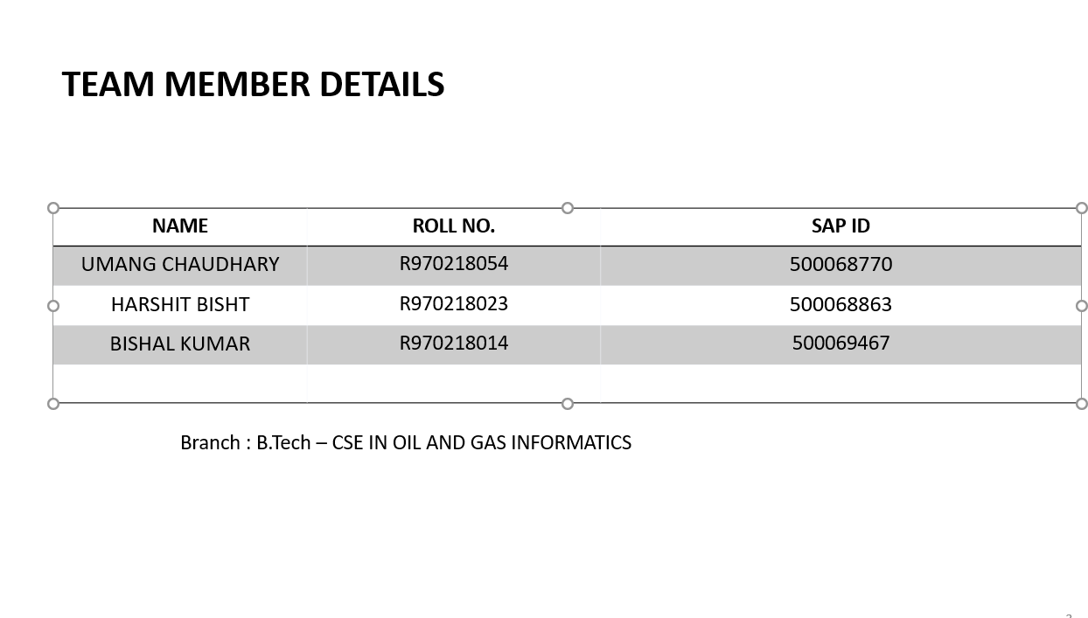

Slide 4
INTRODUCTION
Now-a-day's agriculture is one of the most important field in the emerging real world . It is the spine of Indian Economy.
In India, agriculture is in poor condition since majority of the poor farmers are not getting the expected crop yield due to several reasons.
The farmers necessarily require a timely advice to predict the future crop productivity and an analysis is to be made in order to help the farmers to improve there crop production.(Helping them to take wise decisions)

Slide 5
Continue…
With the help of Regression algorithms, prediction can be done by a farmer in estimating the MSP of his crop.
Providing the data such as crop name, name of the state where the farmer live, which season of growth? and average MSP(Minimum Support Price) from 2011 to 2020 of the crops, can give the YIELD of the Crop to the farmer before sowing the seeds which can improve the agricultural conditions.

Slide 6
OBJECTIVES
Do the analysis and predict the MSP of each crop for the upcoming year by applying linear regression.
Second objective is to help farmers taking decisions related to there crop yield by applying decision tree.
Lastly, building a user interface for porting information to the farmers.

Slide 7
PROBLEM STATEMENT
Farmer requires a timely advice to predict the future crop productivity, which could help them to improve there crop production. Yield prediction is an important agricultural problem no one can predict that with 100% accuracy. The probability of risk is negligible, but a risk factor could be there if our farmers friend are completely dependent on this project model, after all the geographical status of a place is quite unpredictable and hence, some times the outcome may be different.

Slide 8
METHODOLOGY
Linear regression to fine the MSP of the crops for year 2021. And decision tree to find the crop yield in terms of good and bad of all the crops.
Initially the data of MSP i.e. Minimum Support Price of crops and GDP (Gross Domestic Product) have been taken of past 10 years (2011-2020).

Slide 9
Now we will calculated the MSP of a particular crop for year 2021 and repeated the same for all the crops.
Then the classification of crop yield of all the crops is done into 2 types- Good and Bad by analysing according to the survey done in the data set.
Finally by using decision tree we got the yield type of particular crop for a given location and best season for its growth in 2021.

Slide 10
Lastly, a front-end has been prepared which was named as Farmers Advisor.
And linked the outputs of both the algorithms, so that the data of MSP of suitable crops and its crop yield can be displayed on the online portal after farmer providing the inputs.

Slide 11
PROJECT DESIGN

Slide 12
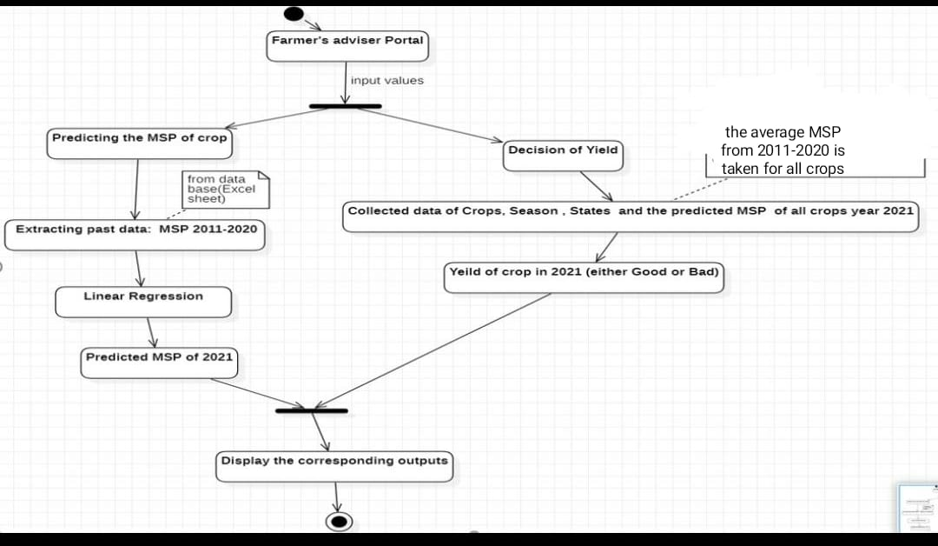
ACTIVITY DIAGRAM
Notes:
Import data set

Slide 13
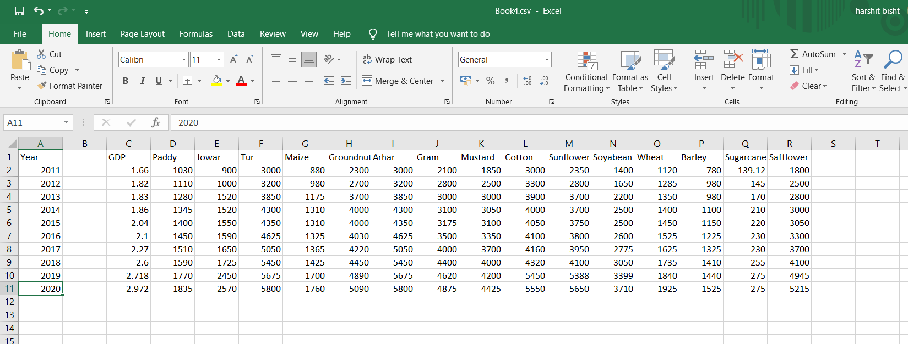
data year GDP and MSP of each crop
Linear Regression algorithm
Notes:
Here we have Year, GDB and MSP of each crop year wise

Slide 14
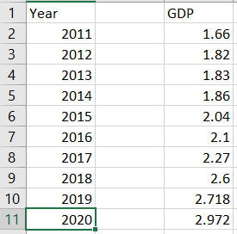
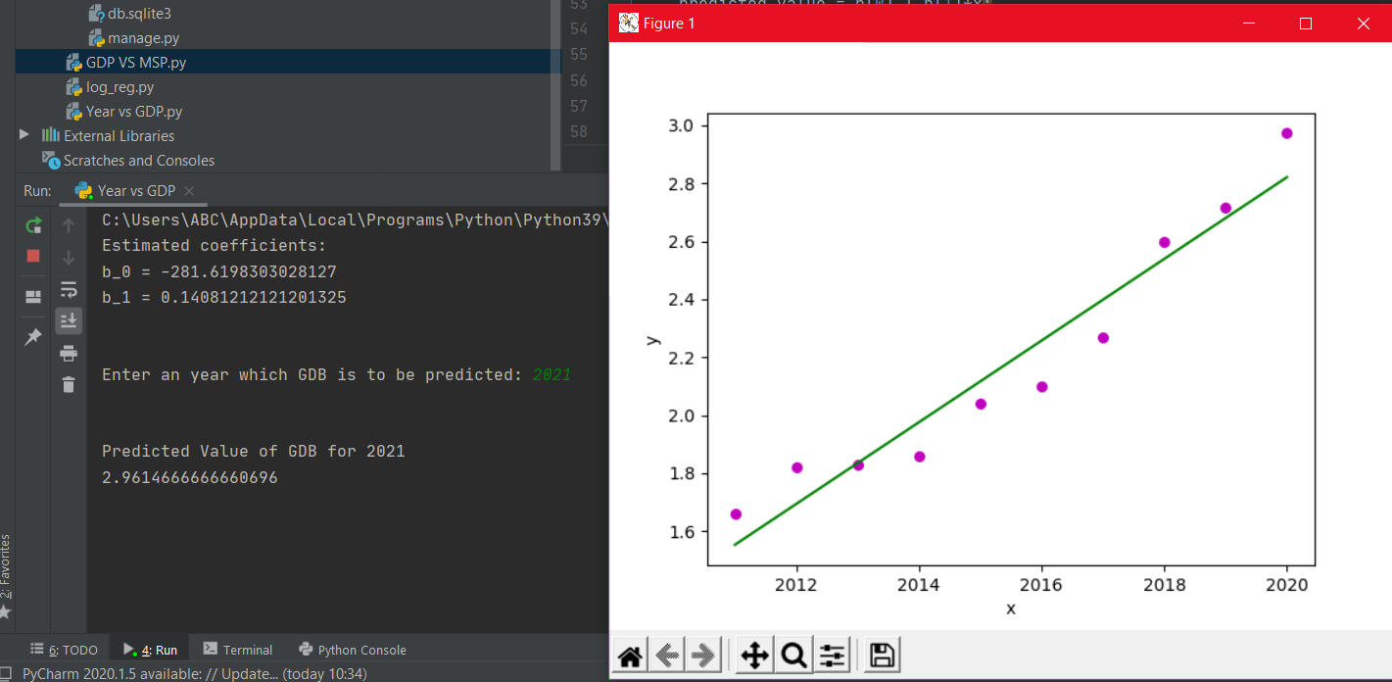
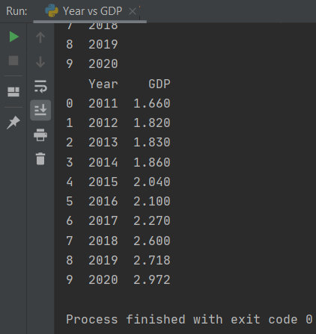
Prediction of GDP of year 2021 using linear regression (GDB VS YEAR GRAPH)
Step 1: From Database
Step 3: Using y=b_0 + b_1*(x) predicting the value of GDB where x= 2021 or x Year
Step 2: Extracted data from Database into python console from year 2011 – 2020 past data
Step 4: OutPut-> 2021 (future) GDB is predicted as 2.9614666668696
Notes:
GDB vs YEAR

Slide 15
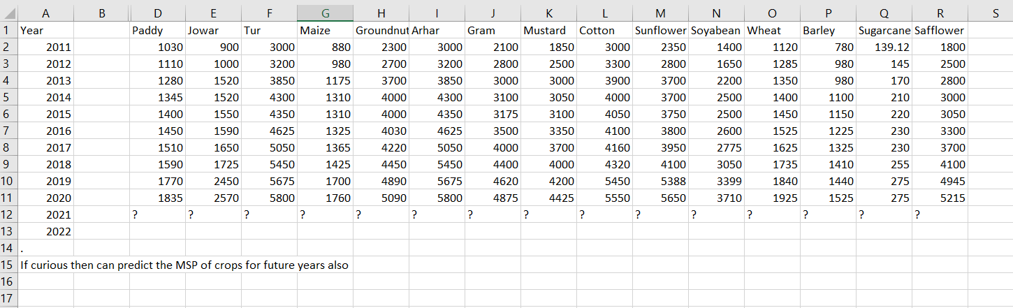
MSP of each crop prediction in 2021
Given MSP of each crop from 2011 – 2020

Slide 16
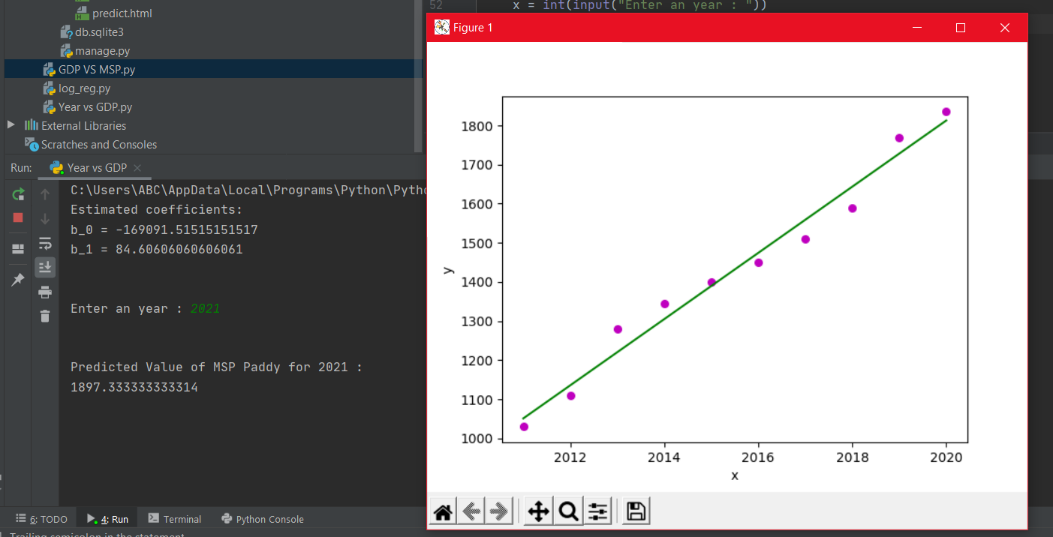
MSP of ‘Paddy’ for 2021 prediction.
The 1st crop in out list ‘Paddy’ MSP prediction for 2021 :
Similarly for each crop we can have the predicted MSP of 2021
Notes:
Calculation of the predicted MSP of each crop in 2021 can be done by making use of loop

Slide 17
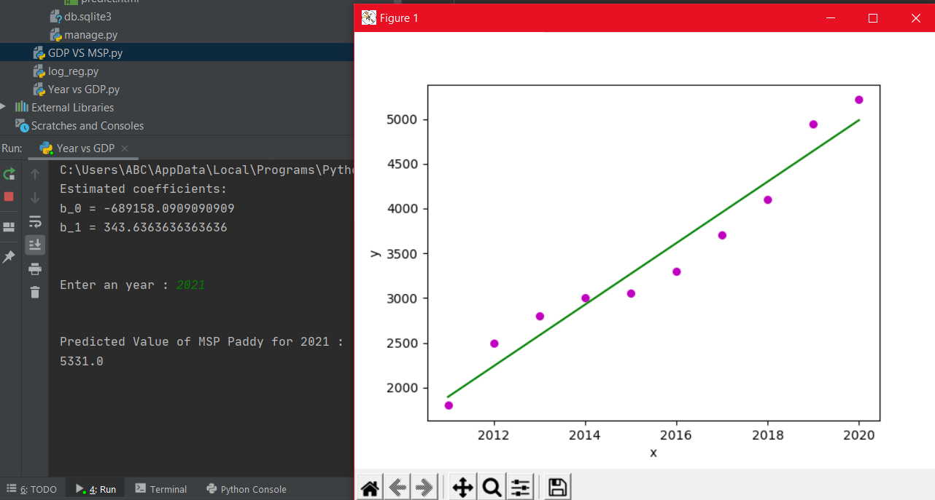
MSP of ‘Safflower’ for 2021 prediction
The last crop in out list ‘Safflower’ MSP prediction for 2021 :

Slide 18
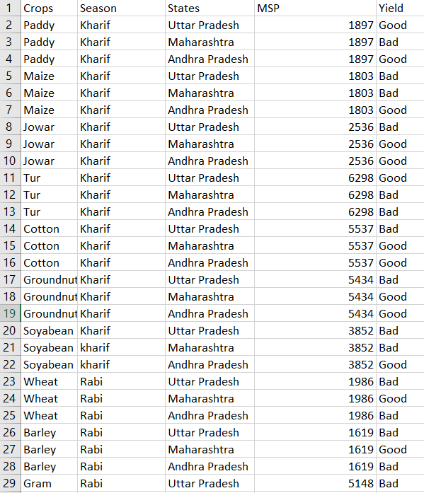
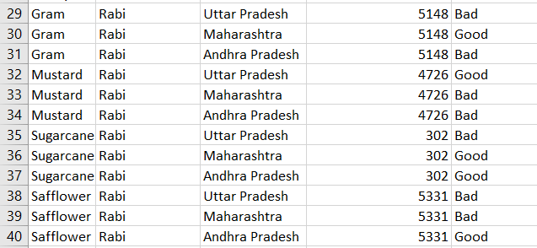
On the basis of attributes the decision tree will take decision either the yield is good/bad
Predicted Crop Yield
Notes:
Kharif : rainy season crop and rabi are winter season and avg MSP (predicted)

Slide 19
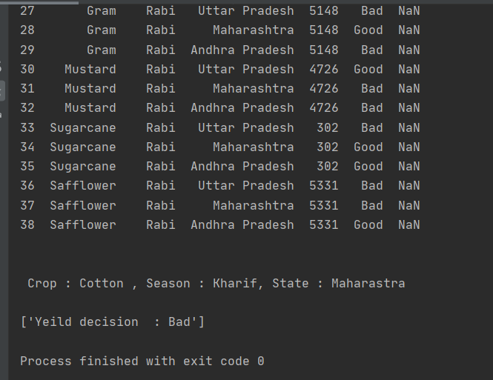
Output of Decision tree :

Slide 20
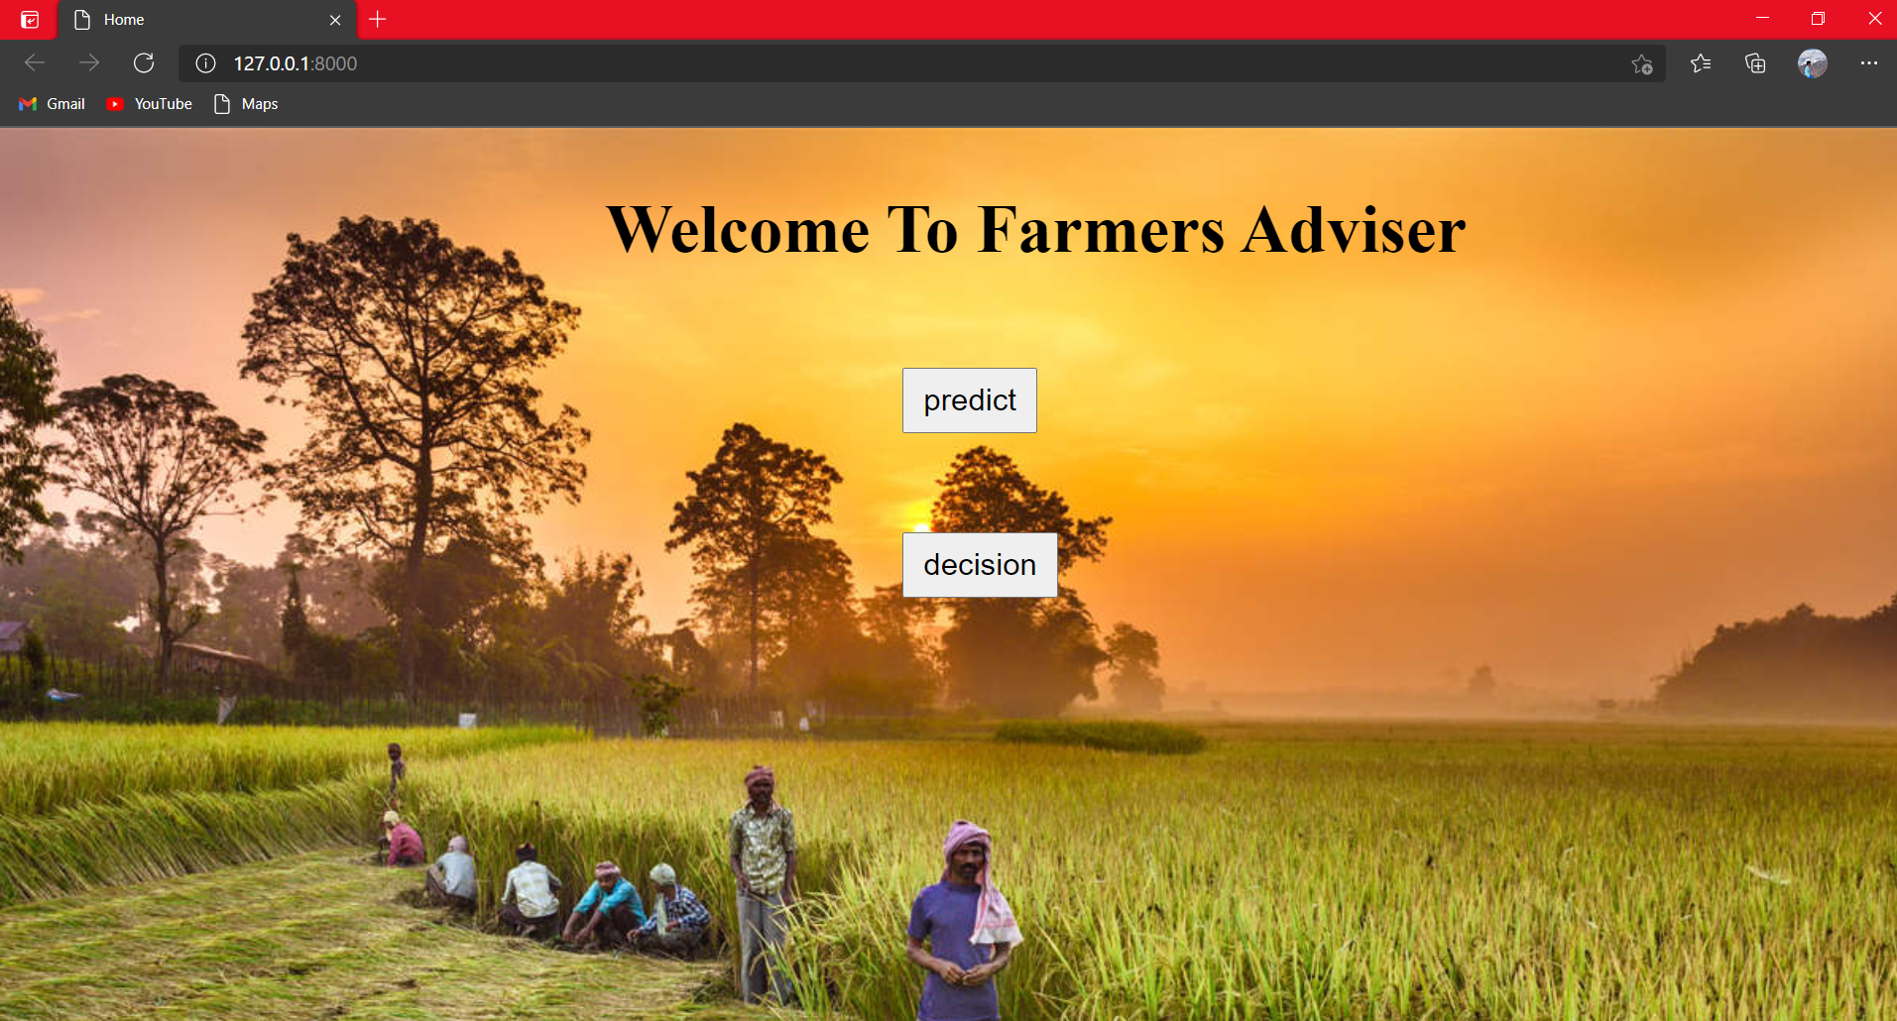
Portal Design

Slide 21
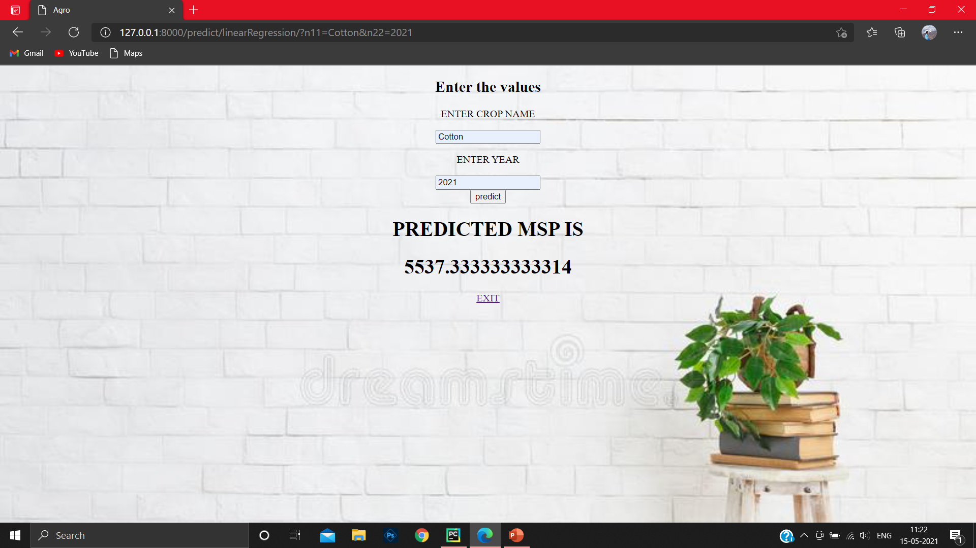
PREDICTION OF MSP

Slide 22
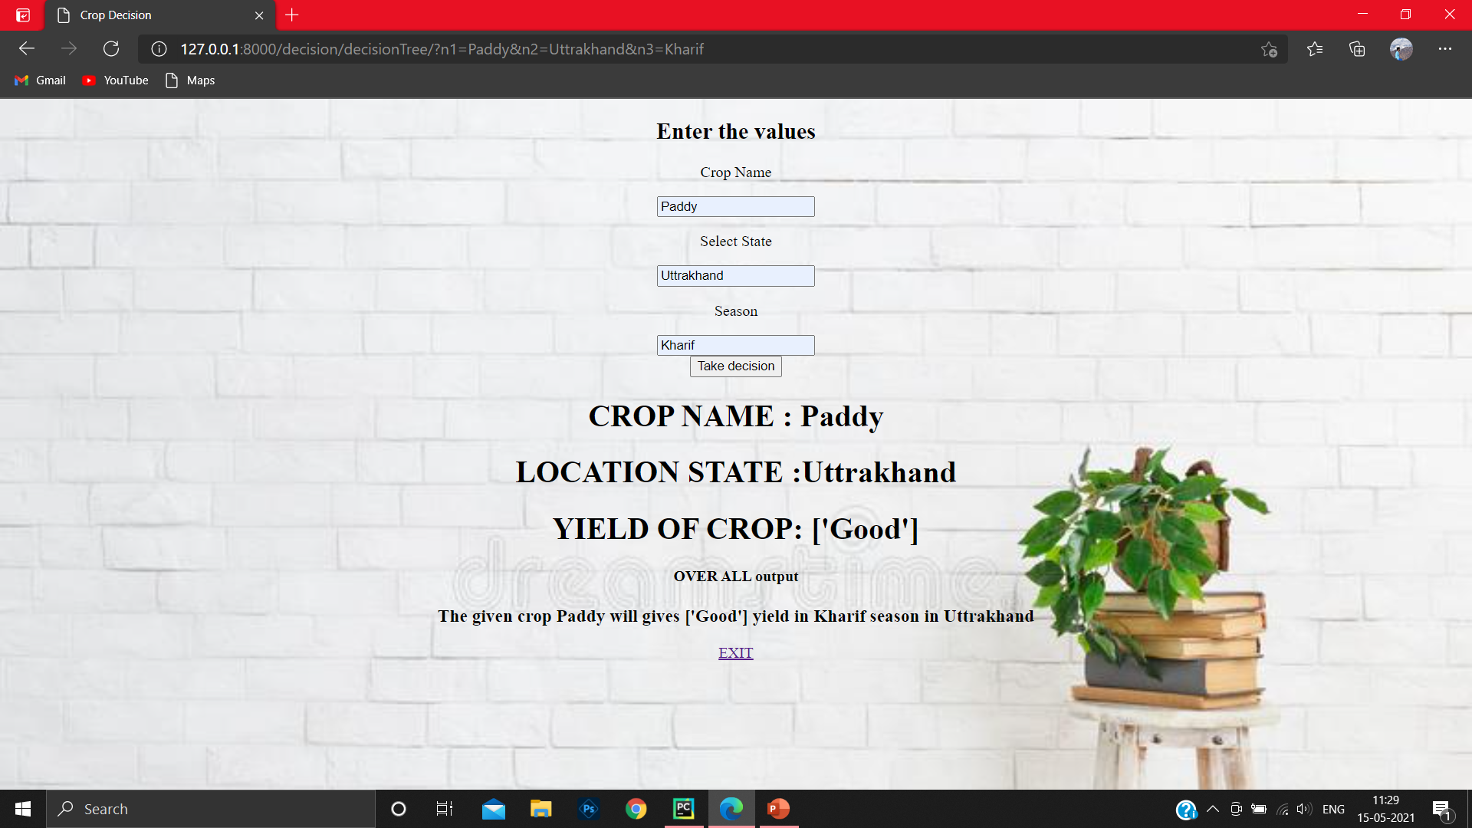
DECISION

Slide 23
TECHINICAL IMPLEMENTATION AND ALGORITHM

Slide 24
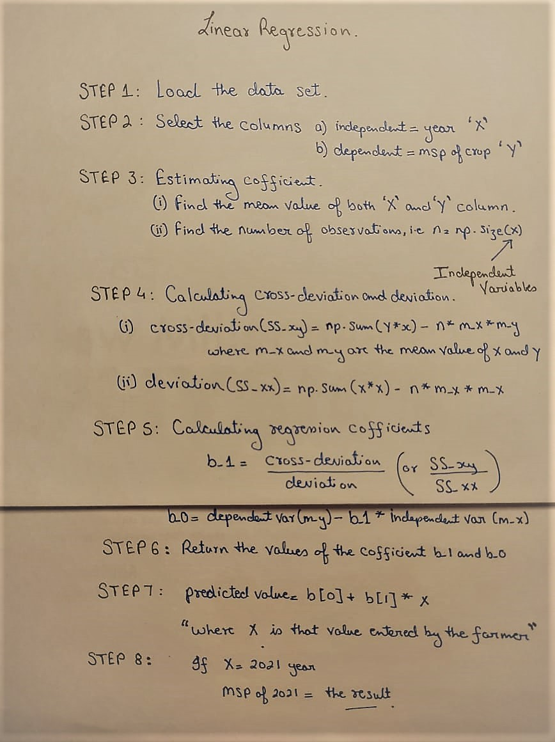
ALGORITHM

Slide 25
IMPLEMENTATION (code snippet)
Linear Regression: Code spippet.
def linearRegression(request):
data_set = pd.read_csv('E:\minor 2 data set\Book4.csv')
data_set.pop('Unnamed: 1') # cleaning extra column print(data_set)
var11 = request.GET["n11"]
var22 = request.GET["n22"]
b = estimate_coef(data_set["Year"], data_set[var11])
print("\n")
x = int(var22)
predicted_value = b[0] + b[1] * x;
print("\n")
answer = str(predicted_value)
return render(request, "predict.html", {"result22": answer})

Slide 26
Continue.. estimate_cof(x,y) method call from linear regression method
def estimate_coef(x, y):
n = np.size(x) # number of observations/points
m_x = np.mean(x) # m_x variable will have the mean of x i.e years
m_y = np.mean(y) # m_y variable will have the mean of y i.e individual crops Msp
# calculating cross-deviation and deviation about x
SS_xy = np.sum(y * x) - n * m_y * m_x #SS_xy is cross deviation
SS_xx = np.sum(x * x) - n * m_x * m_x #SS_xx is deviation
# calculating regression coefficients
b_1 = SS_xy / SS_xx
b_0 = m_y - b_1 * m_x
return (b_0, b_1)

Slide 27
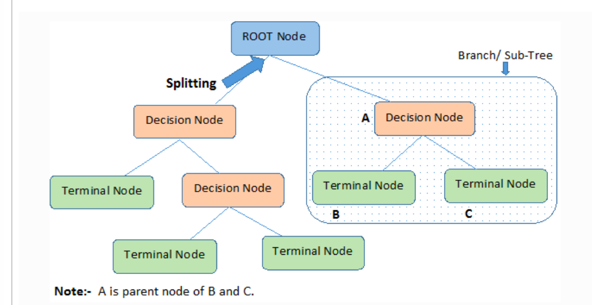
Decision Tree
Important Terminology related to Decision Trees
Root Node: It represents the entire population or sample and this further gets divided into two or more homogeneous sets.
Splitting: It is a process of dividing a node into two or more sub-nodes.
Decision Node: When a sub-node splits into further sub-nodes, then it is called the decision node.
Leaf / Terminal Node: Nodes do not split is called Leaf or Terminal node.
Pruning: When we remove sub-nodes of a decision node, this process is called pruning. You can say the opposite process of splitting.
Branch / Sub-Tree: A subsection of the entire tree is called branch or sub-tree.
Parent and Child Node: A node, which is divided into sub-nodes is called a parent node of sub-nodes whereas sub-nodes are the child of a parent node.
Notes:
Decision Tree algorithm belongs to the family of supervised learning algorithms.

Slide 28
ALGORITHM
Steps in ID3 algorithm:
It begins with the original set S as the root node.
On each iteration of the algorithm, it iterates through the very unused attribute of the set S and calculates Information gain(IG) of this attribute.
It then selects the attribute which has the Largest Information gain.
The set S is then split by the selected attribute to produce a subset of the data.
The algorithm continues to recur on each subset, considering only attributes never selected before.

Slide 29
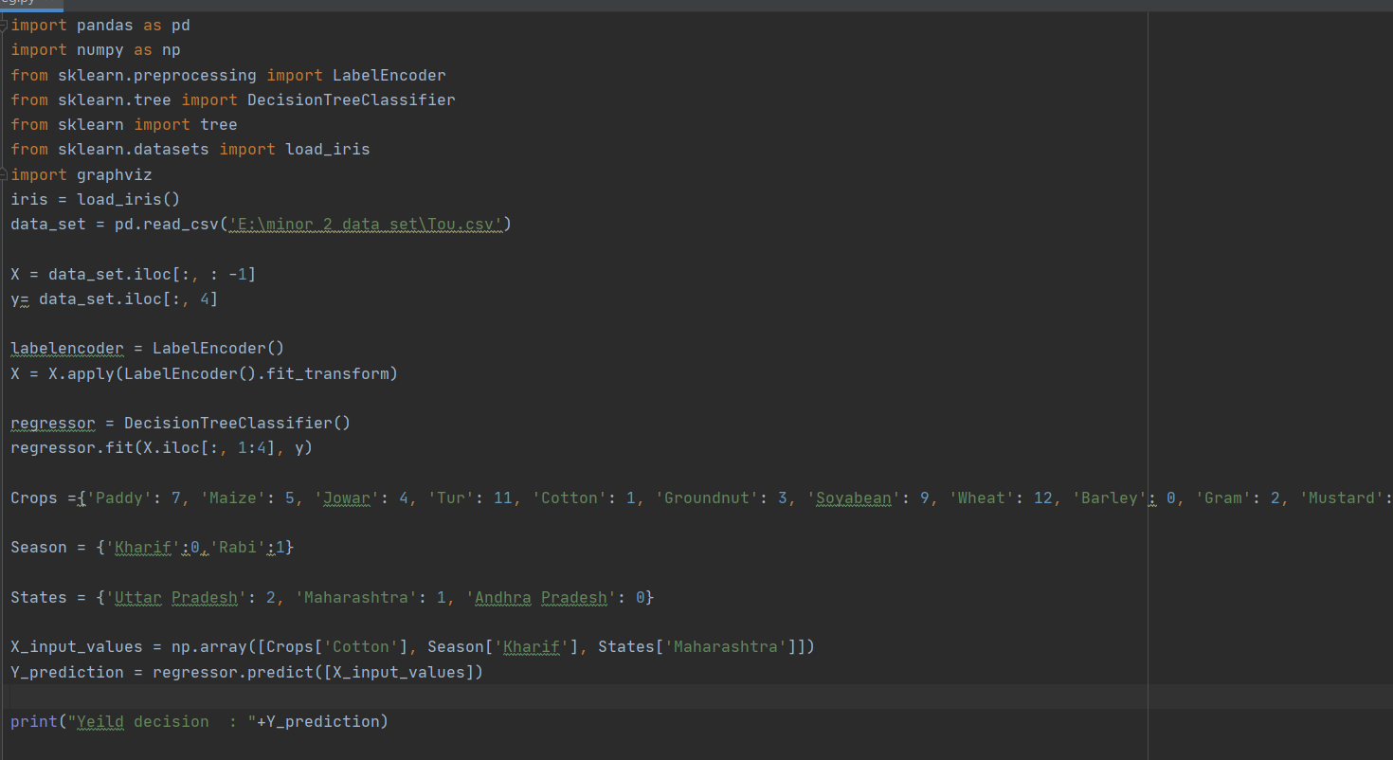
IMPLEMENTATION (code snippet)

Slide 30
RESULT ANALYSIS
The site has been made to port the predictions done by using Linear regression and Decision tree classifier about the MSP of the upcoming year and yield of crops.
The user can enter the required details and the information will be delivered to them based on their requirements.

Slide 31
CONCLUSION a
The project is developed with the aim of resolving the problems and doubts that the farmers face while they give their thoughts on which crop to show.
As farmers are the backbone of our country and facing the unfortunate fact that most of the farmers are illiterate, it is our sole responsibility to help our farmers.
Thus, we came up with the idea of presenting forward the details of the crops that a particular farmer from a particular region in a particular period of the year may require to make the decision that which crop can benefit him according to his convenience.

Slide 32
Source :
Geeks for geek
Data set own little support from internet .

